Slide 1
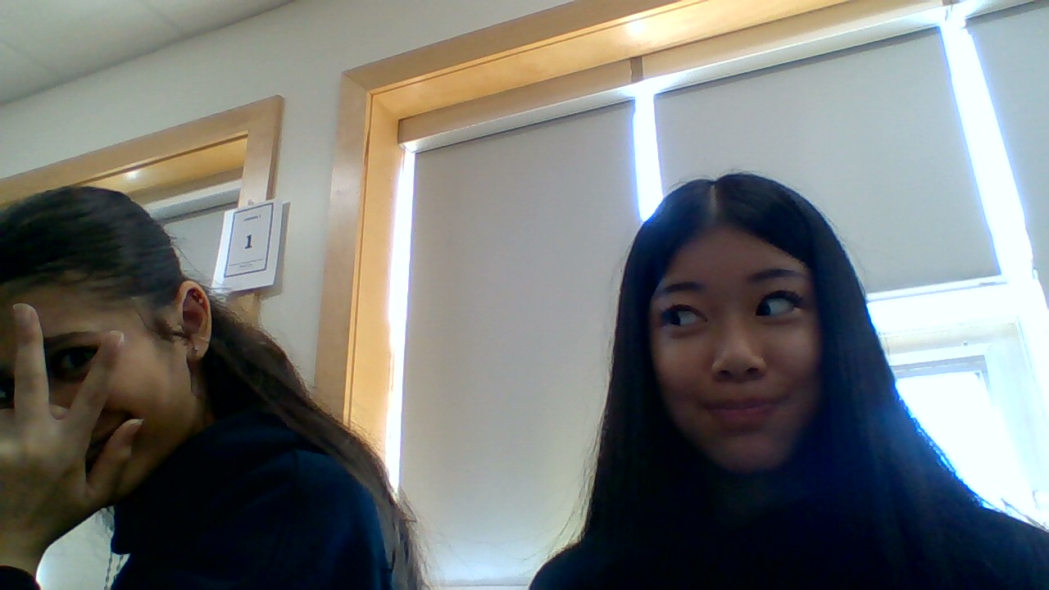
DATE Sept 11 2026
Anna Tan
Citizenship 9
Insert some kind of cool picture here

Slide 2
TABLE OF CONTENTS
TABLE OF CONTENTS
WHERE
1
2
3
4
Personal
Community
Global
Aspirational

Slide 3
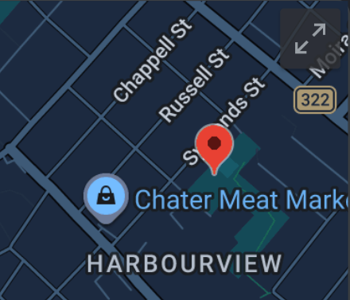
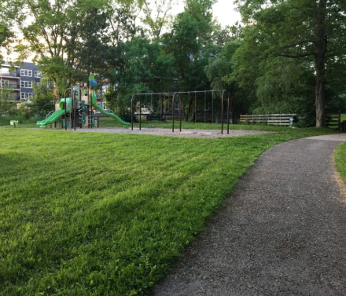
The Personal Place
Cit 9 WHERE
 | One place that holds many memories for me is Northbrook Park, which is near my house. When I was little, I would go there almost every day with my grandparents. I loved running around and playing outside, especially on sunny days when I could feel the warmth of the sun. My sister and I would also spend time on the playground together. Sometimes I would fall while playing, but we would always laugh about it and continue having fun. This park is special to me because it reminds me of my childhood and the time I spent with my family. | IMAGE
Notes:
The Personal Place
Reflection: Write a paragraph about a personal place that holds significance for you.
Guiding Questions:: In a second section, describe how your personal perspective shapes the way you see and feel about this place. What stories or memories are tied to this specific location?

Slide 4
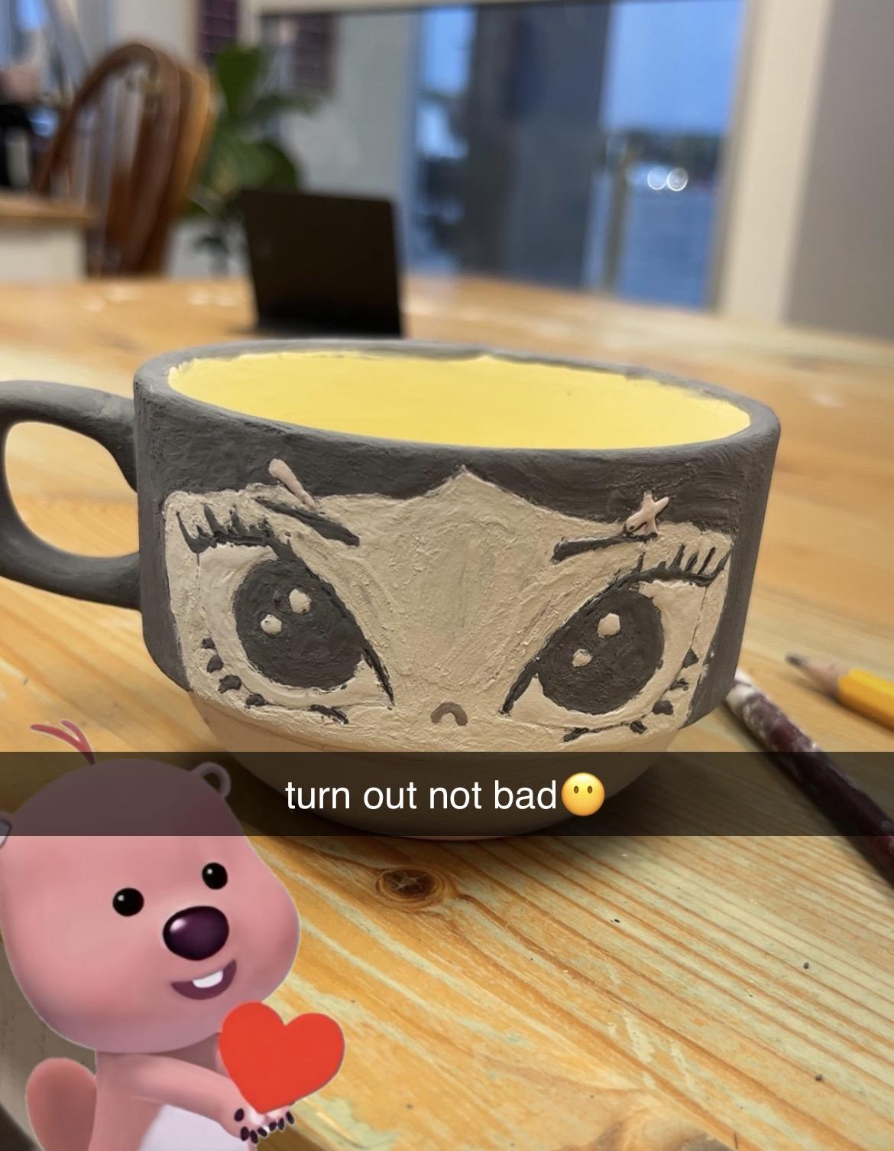
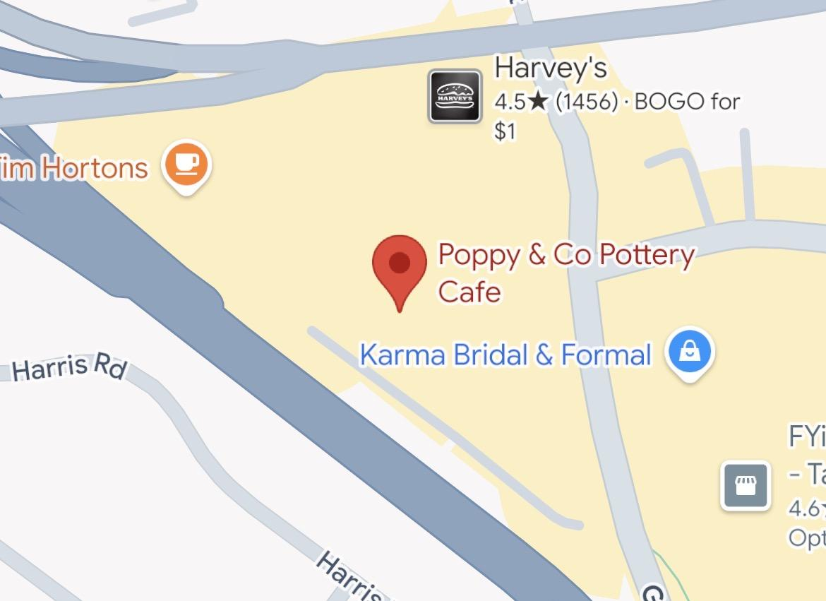
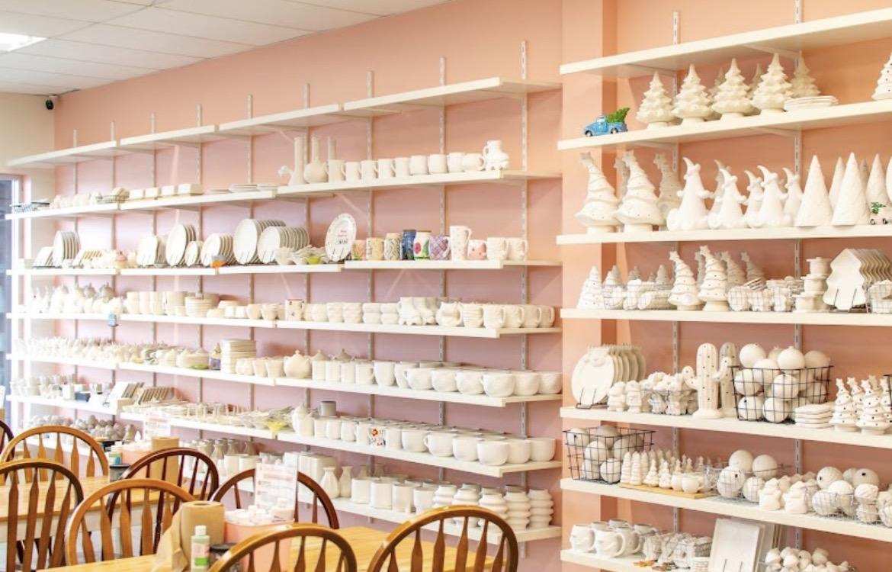
The Community Place
Cit 9 WHERE
 | There is a place in Dartmouth called Pottery & Co. that I really enjoy visiting. Whenever I have free time, I like going there with my friends because we can paint pottery, talk, and relax together. One of the first times I went, I accidentally chose the wrong type of cup and used the wrong type of paint. I thought it did not look very good at first, but I decided to make another one. The second one turned out really well and I was proud of how it looked. The place is also very cute and peaceful, and there is a small bakery where you can enjoy a matcha while painting your pottery.
Notes:
Reflection: Write about a significant place in our local community. Tell the story of the place! Who owns it? Why do you like it? Describe something that happened there that you remember.

Slide 5
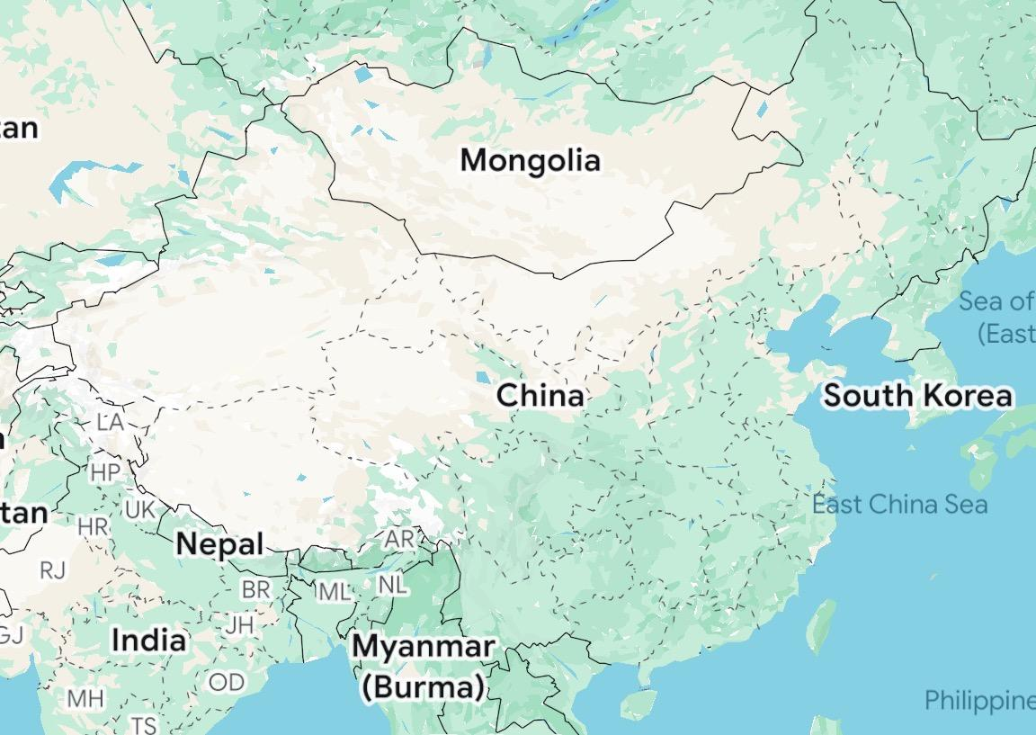
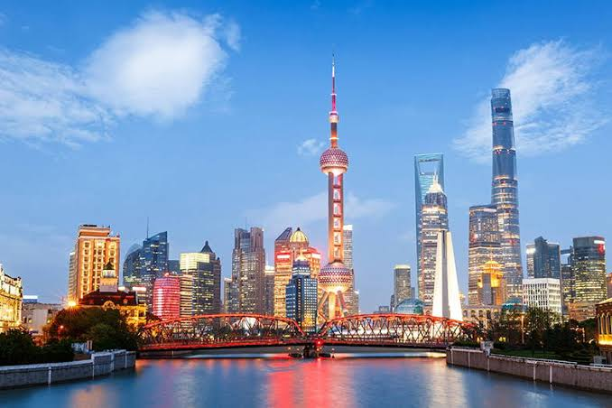
The Global Place
Cit 9 WHERE
 | My family history is connected to China because both of my parents were born there and immigrated to Canada about thirty years ago. Two important traditions that have been passed down in my family are Buddhism and Chinese New Year. During Chinese New Year, we prepare lots of delicious food and invite our family and friends over to celebrate together. One of my favourite foods to have during this celebration is mooncakes because they are really good. These traditions are important to me because they help me stay connected to my family’s culture and history.
Notes:
Reflection: Write a story about a place in the world that is part of your family's story.
Guiding Questions: Tell the story of how you and/or your family are connected to this place.
What traditions or values from this place have been passed down to you?
How does this connect to your cultural identity, including things you do and who you are?

Slide 6
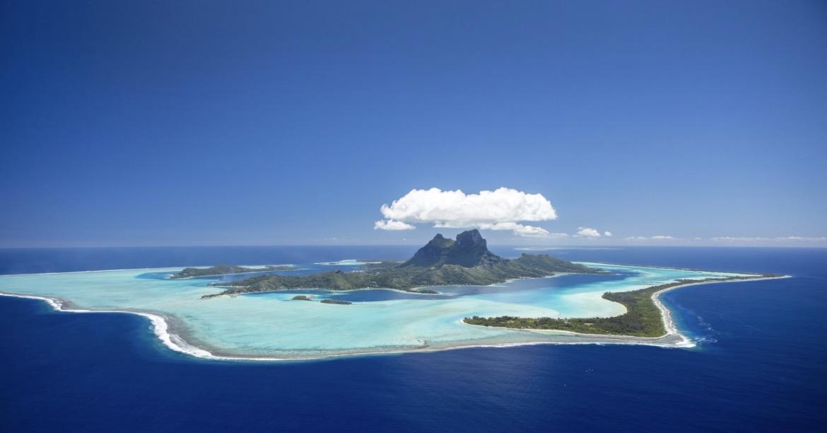
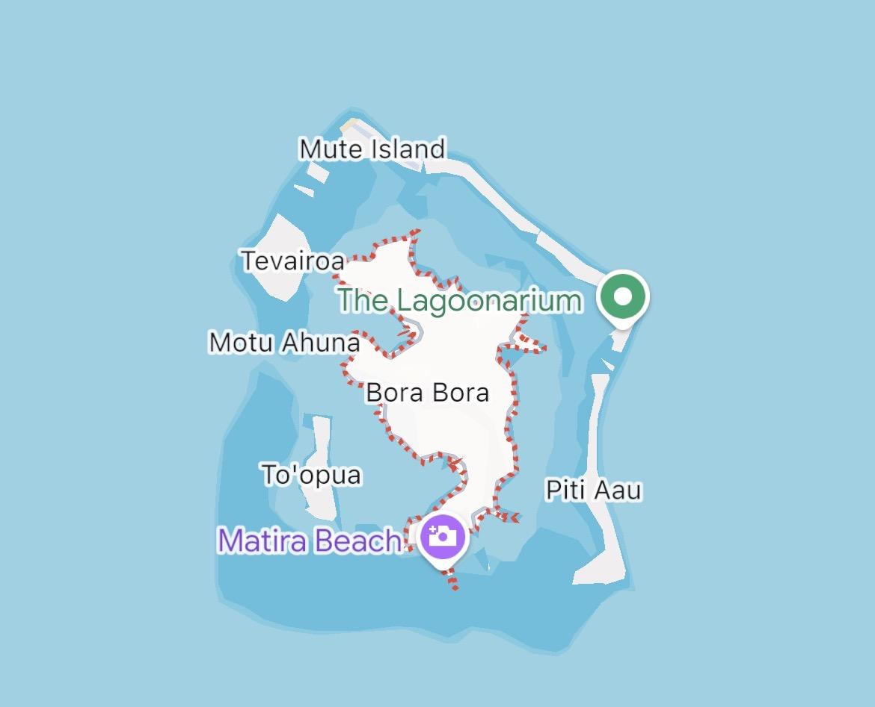
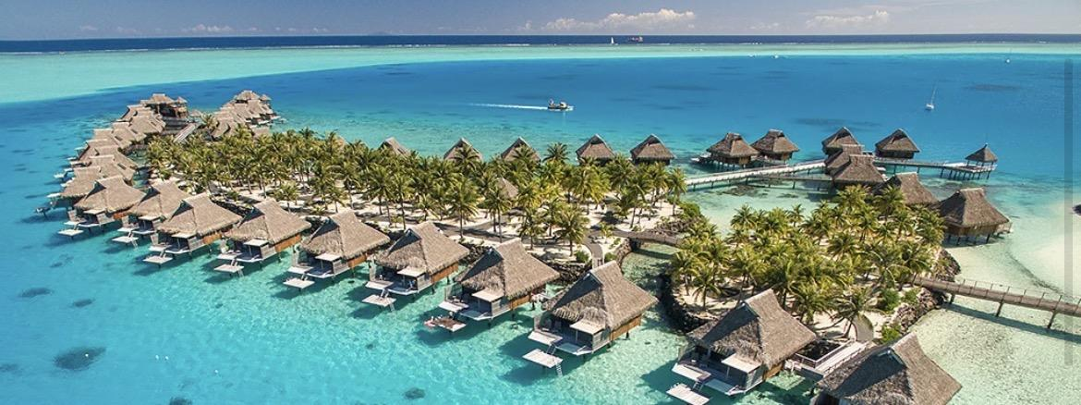
The Aspirational Place
Cit 9 WHERE
 | A place I would love to visit in the future is Bora Bora. The views there look so beautiful and amazing, and I would love to experience them in person. The water is so clear and blue, and it looks like the perfect place to swim and relax. I also think staying there would be an amazing experience because it looks peaceful, luxurious, and beautiful.
Notes:
Reflection: Write a story about a place in the world that is part of your family's story.
Guiding Questions: What draws you to this place? What do you hope to learn or experience there? How does this place fit into your hopes for the future?

Slide 7
The Aspirational Place
Cit 9 WHERE
Dancing queen | The story behind this song reminds me of when I was little and went on my first cruise ship. It was one of the best trips I have ever been on, and I made so many great memories. One memory I remember the most was going to a performance on the ship and watching someone sing and dance to this song. I was completely mesmerized by the performance. It became one of my favourite songs for a long time, and I still sometimes play it in my room because it brings back so many happy memories. | https://youtu.be/xFrGuyw1V8s?si=CXRIZLOyZ3Qq__BM
Notes:
Reflection: Write a story about a place in the world that is part of your family's story.
Guiding Questions: What draws you to this place? What do you hope to learn or experience there? How does this place fit into your hopes for the future?

Slide 8
THANK YOU

